Slide 1
Functional dynamics of bacterial species in
the mouse gut microbiome revealed by
metagenomic and metatranscriptomic
analyses
Author: Y.W. Chung 2020
Eric Gathirwa Kariuki
Journal: PLOSOne
Impact Factor: 2.740
Date: 10/12/2020

Slide 2
Introduction
Despite the microbial communities of the mouse gut being extensively studied, their functional roles and regulations are not yet well elucidated.
Aim of the Study
To investigate the active functions of the microbial communities in the murine cecum by analyzing both metagenomic and metatranscriptomic data on the whole microbiome and specific bacterial species.

Slide 3
Metagenomic and metatranscriptomic analyses can allow for the comprehensive profiling of bacterial composition and functions of the complex gut microbiota.
Traditional methods for profiling microbial composition rely on targeted sequencing of 16S rRNA genes, which analyzes the relative abundance of the species in a microbial community.
Shotgun sequencing is more effective in identifying the abundance and potential functions of bacterial genes in a community since the approach can decode the entire genetic material.

Slide 4
Shotgun sequencing of a metatranscriptome facilitates microbiome analysis with better resolution.
It enables exploration of different functional activities of individual genes in a species or community under different conditions.
By mapping RNA sequencing reads to the known genomes or genes involved in a specific pathway, functional activity can be measured to find up- or down-regulated pathways in the microbial communities under various conditions.

Slide 5
METHODS
The metagenome and metatranscriptome data were generated from eight mice bred under specific pathogen-free animal facilities (SPF).
To estimate the bacterial composition in the gut microbiome, three different approaches were used:
i. 16S rRNA profiling using amplicon sequencing data
ii. 16S rRNA profiling using shotgun sequencing data
iii. Genome-level profiling using shotgun sequencing data
The expression levels were quantified for the dominant species of the normal flora in the murine gut microbiome.

Slide 6
Shotgun sequencing of the metagenome
Isolation of genomic DNA was done using QIAmp DNA Stool Mini Kit (Qiagen).
DNA quality and quantity was assessed using PicoGreen dsDNA quantitation reagent (invitrogen).
Genomic DNA was fragmented into 350bp inserts using an ultrasonicator, phosphorylated and prepared as per Illumina protocols.
The final ligation product was quantified using qPCR and quality assessed using Tapestation 2200 (Agilent).
Sequencing was carried out on the Hiseq 4000 platform (Illumina).

Slide 7
Shotgun sequencing of the metatranscriptome
Total RNA was extracted from the mice caecum using HybridRTM total RNA purification kit (GeneAll Biotech, Korea).
RNA concentration was determined using Quant-IT RiboGreen (Invitrogen).
RNA integrity was assessed using RNA ScreenTape (Agilent) with RIN cutoff of 7.0 for library construction.
Library preparation was done using Illumina TruSeq RNA Prep kit.
RiboZero kit was used to degrade rRNA and remove host RNA by means of selective polyadenylation using magnetic beads.

Slide 8
Second strand cDNA synthesis using SuperScript II Reverse Transcriptase (Invitrogen) followed by end repair of cDNA fragments and ligation of the indexing adapters.
The products were purified and enriched by PCR to create final cDNA library.
Quantification of the libraries was done using qPCR. Quality of the reads was assessed using TapeStation D1000 ScreenTape (Agilent)
Sequencing was done on the Hiseq 4000 platform by Macrogen Technologies, Seoul, Korea.
Sequencing data from this study are available at ENA with the accession number PRJEB33889.

Slide 9
Processing of shotgun sequencing reads
Adapter sequences were removed using SeqPurge, low quality reads (less than Phred Score 20) were removed using Sickle while N-containing reads were removed using in-house scripts.
3.01% and 0.13% of reads were discarded from the metagenomic and metatranscriptomic samples respectively.
Host reads were removed by mapping against USCS mouse ref. Genome using Bowtie. Consequently, 12.04% and 7.56% of reads were discarded from metagenomic and metatranscriptomic samples respectively.
Metatranscriptomic reads were further mapped to mouse mRNA to remove the reads and an average of 0.02% were removed.

Slide 10
rRNA were removed using SortMeRNA while duplicated reads were removed using FastUniq.
An average of 0.42% and 0.29% were filtered as rRNA reads while 3.88% and 17.11% were removed as duplicated reads for metagenomic and metatranscriptomic sequences respectively.
Contigs were assembled from each metagenomic and metatranscriptomic sequence using Megahit with default parameters.
For rRNA reads, SortMeRNA was used to obtain 16S rRNA reads using 16S rRNA database. The 16S rRNA reads that were retained, were used for the analysis of bacterial composition.
Notes:
Explain reason why rRNAs are removed.

Slide 11
Examination of bacterial composition
Amplicon sequencing reads were assembled by FLASH. Incorrectly assembled reads whose lengths were shorter than 380 bp were filtered out using Sickle.
Operational Taxonomic Units (OTUs) were constructed for 16S rRNA-based profiling by 99% sequence similarity threshold.
Their representative sequences were classified by RDP naïve Bayesian classifier, which classified all inputs from the phylum to the genus level and reported their scores.
Classification results with confidence above 0.8 were considered to avoid misclassification.

Slide 12
Bacterial composition was analyzed using the metagenomic sequences searched against the NCBI RefSeq database.
Metagenomic reads were also searched against all proteins using DIAMOND with 70% identity and query coverage cutoff.
Metagenomic reads were searched against the selected reference genomes using Bowtie. Best hits whose percent identities were higher than 85% were retained.
Aligned reads were classified based on the NCBI taxonomy and bacterial composition was estimated by tallying mapped reads.

Slide 13
Examination of functional contents
To examine the functional contents, processed reads and proteins were searched against KEGG protein database using DIAMOND.
Database proteins that have no KEGG Ortholog (KO) number or have KO number without functional classification were discarded.
Reads per Kilobase Million (RPKM) is a normalized unit of transcript expression and was calculated for the reads.
Notes:
DIAMOND is a protein aligner. It is also BLAST compatible.

Slide 14
RPKM:
RPKM = x × 10^9/(y×z)
x = Number of reads mapped to the gene
y= Length of the gene sequence
z = Total number of mapped reads in the sample
Statistical Analysis:
For statistical analysis of expression level, t-test was performed by using python statistics library of scipy.stats.
For regression analysis, functions lm was used from standard R package.
Notes:
t test measures whether there is a significant difference between the means of the two groups being compared, and tell whether it is possible that the differences happened by chance.
DESeq2 uses negative binomial distribution and shrinkage methods i.e. (log2fold changes) to infer significant changes between the parameters being investigated.

Slide 15
RESULTS AND DISCUSSION
Bacterial composition of the mouse gut microbiome
Despite the use of three different approaches each with its own limitations, 16S rRNA-based profiling with amplicon sequencing data, 16S rRNA-based profiling extracted from shotgun sequencing data, and genome-based profiling with shotgun sequencing data, the overall composition revealed by the three approaches was consistent and complementary.
After low-quality reads were filtered, an average of 77.77% of the metagenome was retained.

Slide 16
Taxonomic assignment was performed at the phylum, family and genus level. All the 3 approaches revealed Bacteroidetes as the most abundant phylum.
Most Bacteroidetes strains were classified into the family Muribaculaceae. This constituted to roughly 54.99% to 83.44% of the microbial community in the eight metagenome samples analyzed by genome-based profiling.
Barnesiellaceae was the most abundant family in 16S rRNA profiling based on amplicon sequencing and shotgun sequencing data.
This discrepancy is due to the different versions of taxonomic classification that each method uses.

Slide 17
For example, the family Muribaculaceae is annotated in NCBI taxonomy and its genome could be identified, while this family is not included in the RDP classifier model.
The RDP classifier predicted this family as Barnesiellaceae, which is close to the family Muribaculaceae.
The second most abundant phylum was Firmicutes, while the third was Deferribacteres.

Slide 18
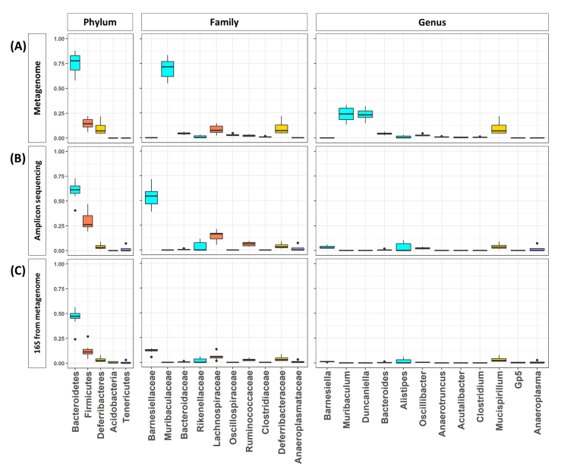
Fig 1:Bacterial composition of the eight mice gut microbiome estimated by the three different approaches.

Slide 19
Distribution of functional contents encoded in the predominant genera of the mouse gut microbiome
The analysis of bacterial composition revealed that nine major genera constitute the mouse gut microbiome by genome-based profiling.
All the strains identified in each genus were analyzed to determine the functions encoded in the genome.
Three strains were randomly selected from each genus for better comparison of the functions in the genome of the nine genera (except two) (Table1).

Slide 20
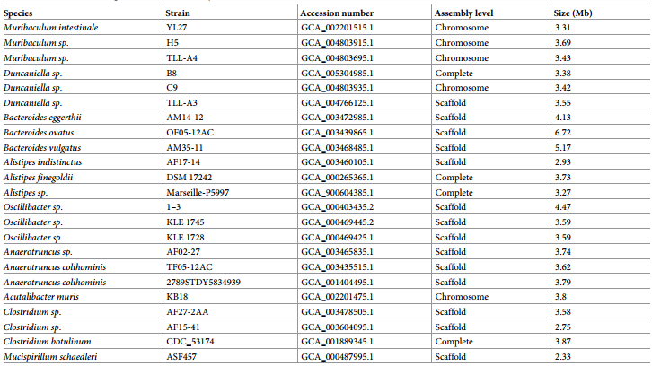
Table1: Strains of the nine genera used for the analysis of functional distribution
Notes:
Three strains were randomly selected manually from each genus (except two).

Slide 21
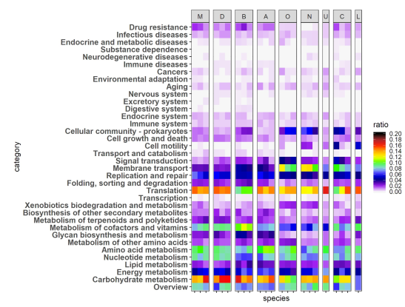
Fig 2: Abundance of functional contents encoded in the genomes of major nine genera in the mouse gut. Each column represents one species.
Labels on the top represent each genus.
M: Muribaculum,
D: Duncaniella,
B: Bacteroides,
A: Alistipes,
O: Oscillibacter,
N: Anaerotruncus,
U: Acutalibacter,
C: Clostridium, and L:Mucispirillum.
Each row represents a functional category in KEGG pathway.
Each cell represents a ratio of genes in a specific genome, which is related to a given functional category.
Notes:
35 major KEGG pathways.

Slide 22
Translation and carbohydrate metabolism were the most abundant functions among the 35 KEGG pathway categories.
In Bacteroides, carbohydrate metabolism was the most abundant, while translation was less abundant as compared to the other eight genera.
Muribaculum, Duncaniella, and Alistipes showed similar functional distribution patterns as the amount of genomic content for carbohydrate metabolism was comparable to that for translation.
The genomic content for metabolism of cofactors and vitamins was more enhanced in Muribaculum, Duncaniella, Bacteroides, and Alistipes. The increase of genomic content for membrane transport was also distinct in Oscillibacter, Anaerotruncus, and Clostridium.

Slide 23
Differentially expressed genes of the predominant genera in the mouse gut
The expression of bacterial genes was quantified by all metagenomic and metatranscriptomic reads that were mapped against the reference genomes of the most abundant species.
Among the reference genomes in the NCBI repository, the closest strains were selected for each species.
The abundance of each gene was measured by RPKM to determine the distribution of expression levels across the entire set of genes in each species. T. test was used for comparison.
The uneven abundance of genes can be attributed to uneven sequencing.
Notes:
T. test compares the expected and observed means on the expression levels quantified using RPKM.

Slide 24
Three genera Muribaculum, Duncaniella, and Mucispirillum that had enough reads with over 80% of the genome, and their functional distribution was estimated based on the KEGG classification.
The reads of the metagenome and metatranscriptome that were mapped to the genera and the functions in the KEGG database, were quantified and normalized.
Comparison of the function distributions of the metagenome with the metatranscriptome revealed the differential expression of functions at the genomic and transcriptomic levels.

Slide 25
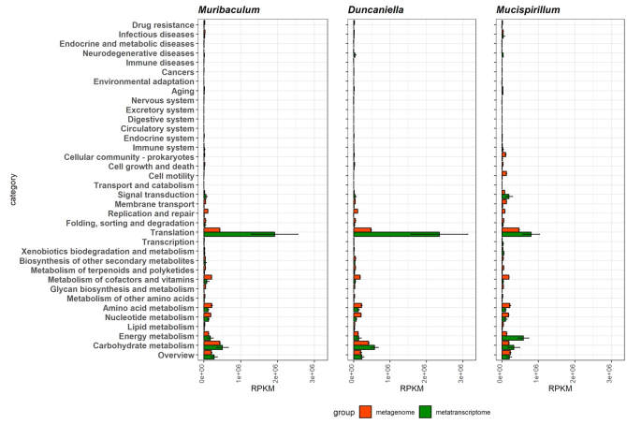
Fig 3: Abundance of functional contents measured from metagenomic and metatranscriptomic reads.
Metagenomic and
metatranscriptomic reads mapped to the top three genera (Muribaculum, Duncaniella, and Mucispirillum) were classified against
the KEGG database.

Slide 26
The expression level of carbohydrate metabolism was up-regulated in all three genera of Muribaculum, Duncaniella, and Mucispirillum.
The expression level of metabolism of cofactors and vitamins, amino acid metabolism, and nucleotide metabolism was down-regulated in all three genera of Muribaculum, Duncaniella, and Mucispirillum.
For energy metabolism, expression rate was not changed in Muribaculum and Duncaniella, but it was dramatically up-regulated in Mucispirillum.

Slide 27
Functional dynamics of the metagenome and metatranscriptome
KEGG was used for pathway analysis for both metagenomic and metatranscriptomic data.
Among 7 functions with the highest level in KEGG pathways, genetic information processing function was the most dominantly expressed in transcriptomic data due to the translation function.
Translation was the significantly abundant function in the metatranscriptomic data, compared to the metagenomic data.
Replication and repair function was however, less abundant in the metatranscriptomic data.

Slide 28
Metabolism functions constituted a large proportion of both the metagenomic and metatranscriptomic data.
Carbohydrate metabolism, amino acid metabolism, nucleotide metabolism, energy metabolism, and metabolism of cofactors and vitamins were the abundant functions, which constituted more than 73.05% and 73.52% of metagenomic and metatranscriptomic reads.
Carbohydrate metabolism constitutes 35.98% in transcriptomic contents, compared to 25.95% of metabolism in genomic contents. Energy metabolism showed a similar pattern: 13.57% in transcriptomic contents vs 8.45% in genomic contents.

Slide 29
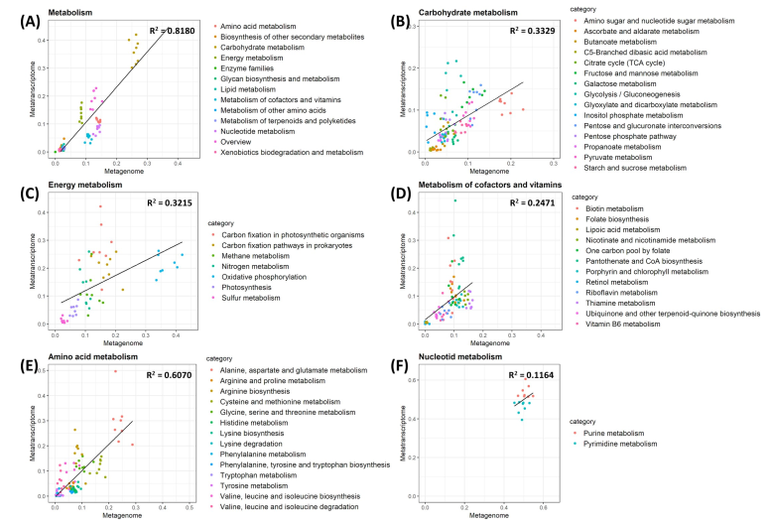
Fig 5: Relative abundance of genomic contents of metabolism and their expression activities in the metagenome and metatranscriptome in each metabolic category.
The lines represent the relationship between the relative abundance of metagenome and metatranscriptome by linear
regression.
Notes:
It is important to note that most abundance of genomic contents occurs in the metatranscriptome with the exception of nucleotide metabolism.

Slide 30
Diversity Analysis
To profile the abundance of functional genes, genes were predicted from both the metagenomic and the metatranscriptomic data sets, and mapped against the KEGG protein database.
The functional diversity was compared among the metagenomic and metatranscriptomic data sets using Principal Component Analysis (PCA).
The metagenomic data were closely clustered, while the metatranscriptomic data were more scattered.

Slide 31
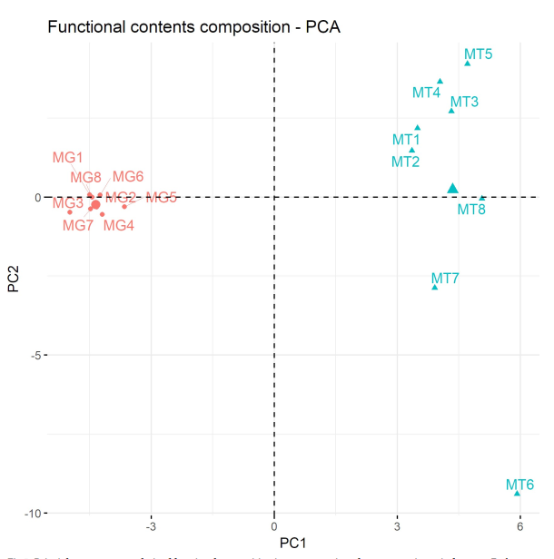
Fig 6: Principal component analysis of functional composition in metagenomic and metatranscriptomic data sets.
Each sample was colored based on their source; metagenome sample is indicated by coral and metatranscriptome sample by mint color.

Slide 32
The PCA analysis implies the following:
i. Functional activities of the microbiome are more dynamic in different mice despite similar patterns in the genomic contents.
ii. Functional distribution between the two datasets differs significantly.
Microbial genes encoding ribosomal proteins are some of the most highly and variably expressed genes in the metatranscriptomic data.
These high expression levels can be attributed to their high abundance at the DNA level.

Slide 33
CONCLUSION
The study demonstrated a methodology for linking and comparing genomic and transcriptomic datasets to examine the functional activities of specific bacterial species in a complex microbial environment.
From investigating the normal mouse flora using the three approaches, Muribaculaceae, Lachnospiraceae, and Deferribacteraceae were identified as the predominant bacterial families.
The overall bacterial composition was consistent, and the discrepancy was mostly due to the different taxonomic classifications used in the different databases.
Notes:
Discrepancy due to database variations

Slide 34
Expression rates were found to differ between metagenomic and metatranscriptomic data.
Translation and carbohydrate metabolism were the most abundant functions among 35 KEGG pathway categories in the nine most abundant genera.
Based on functional classification via the KEGG database, the genes involved in translation, carbohydrate metabolism, and energy metabolism exhibited higher expression at the metatranscriptomic level, compared to that at the metagenomic level.
The study intends to facilitate future development of diagnosis and pre/probiotic treatment.

Slide 35


CRITIQUE
In-depth study that validates the functional activity of commensal microbes from the most abundant genera within the mouse gut, using metagenomic and metatranscriptomic analyses.
Unique technique of metatranscriptomic analysis and DEA.
Indicated title can be misleading.
Possible confusion of the techniques used to the reader.
Gross publication errors (typos).

Slide 36

T H A N K Y O U F O R L I S T E N I N G !
Any
Questions ...

